Slide 1
Prediction of Member Engagement
Biostatistics Capstone Project Group 4

Slide 2






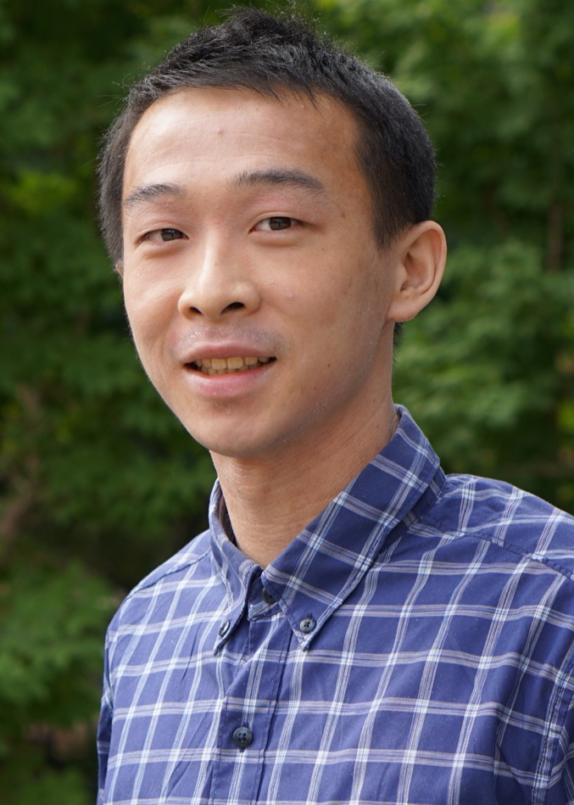

Our Team
Mandira Shrestha
Danielle Brinkley
Patrick J. Heagerty
Lloyd Mancl
Thuy Nguyen
Jiayu Sun
Lester Tsai
Lishan Wang
Notes:
Mandira Shrestha: Healthcare Data Scientist at Community Health Plan of Washington
Danielle Brinkley: Senior Director, Population Analytics at Community Health Plan of Washington

Slide 3
Introduction
Case Management
Community Health Plan of WA
Care Management Services
Disease Management
Optimize Clients’ Well-being
Community Support Services
Challenges:
There are limited resources in CHPW, making it challenging to outreach to everyone
It is difficult to identify the members that will opt-in and engage in CHPW’s programs

Slide 4
Objectives
Utilize machine learning techniques
Build predictive models to predict member engagement
Evaluate model performance
Extract important features

Slide 5
Source of Data
By the State
By Providers and Hospitals
By CHPW
Demographics
Line of business (Medicare, Medicaid, etc.)
Enrollment
Claims
Diagnosis data
Health risk assessment
Risk score/risk level
Customer service calls
Notes:
Demographics include census data;
Claims include medical expenses of members
diagnosis data are transformed into certain diseases.

Slide 6
Overview of Data
Participants: all members outreached for care management services (Mar. 2020 - Nov. 2022) in WA
Sample Size: 44,123 observations
Outcome: engagement status in care management services (binary, 38% engaged vs 62% not engaged)
Predictors:
96 in the original dataset
85 used in model fitting, excluding irrelevant variables (such as ID) and variables with too much missingness

Slide 7
Missing Data
Preferred - Text
Preferred - Mail
Preferred - Email
Preferred - Call
Survey (Health Coaching)
Survey (Case Management)
Self assessed health
> 60%
Missing
Remove these variables
Language
Census Variables
Ethnicity
Race
Hospice
Healthome engaged
Zipclass
Region
< 15%
Missing
Imputation by “MissForest” algorithm

Slide 8
Methods
Splitting data: Training (80%) vs Test (20%)
Train models on the training set
(use 10-fold cross-validation to tune hyperparameters)
Lasso Regression
Random Forest
XGBoost
BART
Evaluate models on the test set

Slide 9
Methods
Lasso Regression
Random Forest
XGBoost
BART
Pros:
simple and fast
feature selection
avoid overfitting
interpretability
Cons:
linear hypothesis
feature selection can be biased
Pros:
flexible
learn non-linear relationship
can assign feature importance
Cons:
blackbox
relatively slow
Pros:
same pros as random forest
faster
usually better performance
Cons:
blackbox
may overfit
Pros:
same pros as random forest
use regularization prior to avoid overfitting
Cons:
blackbox
large memory
Complexity
Interpretability

Slide 10
Results
Evaluation metrics for different models (threshold = 0.4)
 | Lasso | Random Forest | XGBoost | BART
Accuracy | 0.62 | 0.62 | 0.62 | 0.63
Sensitivity | 0.53 | 0.59 | 0.55 | 0.47
Specificity | 0.67 | 0.64 | 0.66 | 0.73
AUC Score | 0.66 | 0.67 | 0.67 | 0.67

Slide 11
Results
Prediction by different choices of thresholds
Threshold | Sensitivity |  |  |  | Specificity
 | Lasso | RF | XGBoost | BART | Lasso | RF | XGBoost | BART
0.25 | 0.94 | 0.94 | 0.87 | 0.83 | 0.21 | 0.24 | 0.33 | 0.39
0.3 | 0.87 | 0.87 | 0.78 | 0.67 | 0.32 | 0.33 | 0.44 | 0.55
0.35 | 0.72 | 0.75 | 0.67 | 0.52 | 0.51 | 0.47 | 0.54 | 0.69
0.4 | 0.53 | 0.59 | 0.55 | 0.47 | 0.67 | 0.64 | 0.66 | 0.73
0.45 | 0.38 | 0.42 | 0.44 | 0.32 | 0.80 | 0.78 | 0.75 | 0.82
0.5 | 0.25 | 0.26 | 0.34 | 0.23 | 0.88 | 0.88 | 0.81 | 0.89
0.55 | 0.16 | 0.15 | 0.25 | 0.18 | 0.93 | 0.95 | 0.87 | 0.92
0.6 | 0.11 | 0.08 | 0.18 | 0.16 | 0.96 | 0.98 | 0.91 | 0.93
0.65 | 0.07 | 0.03 | 0.13 | 0.1 | 0.98 | 0.99 | 0.94 | 0.96
0.7 | 0.04 | 0.01 | 0.09 | 0.09 | 0.99 | 0.996 | 0.96 | 0.97
0.75 | 0.02 | 0.003 | 0.06 | 0.06 | 0.99 | 0.999 | 0.98 | 0.98

Slide 12
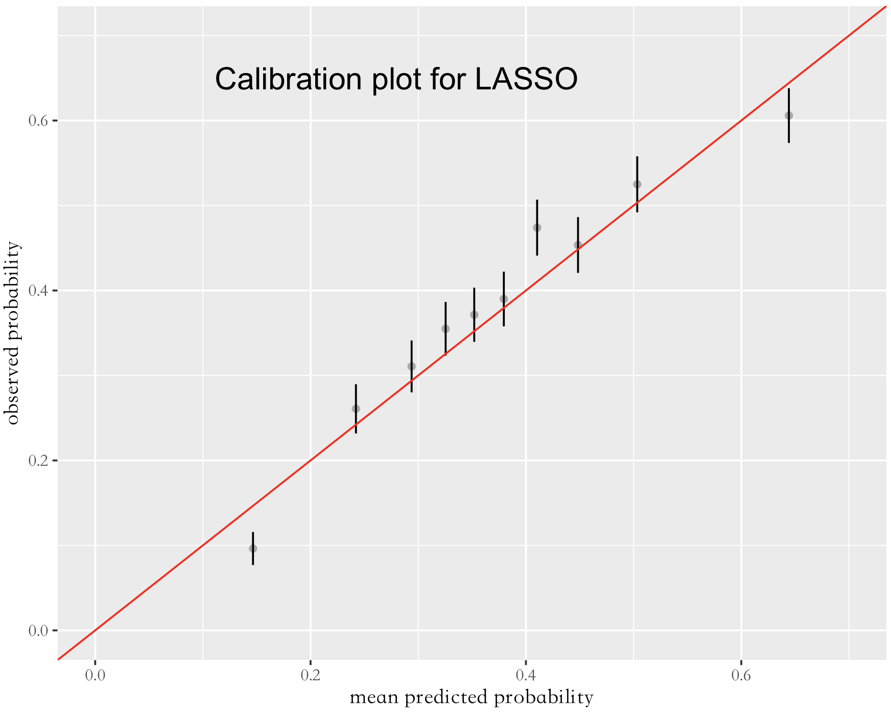
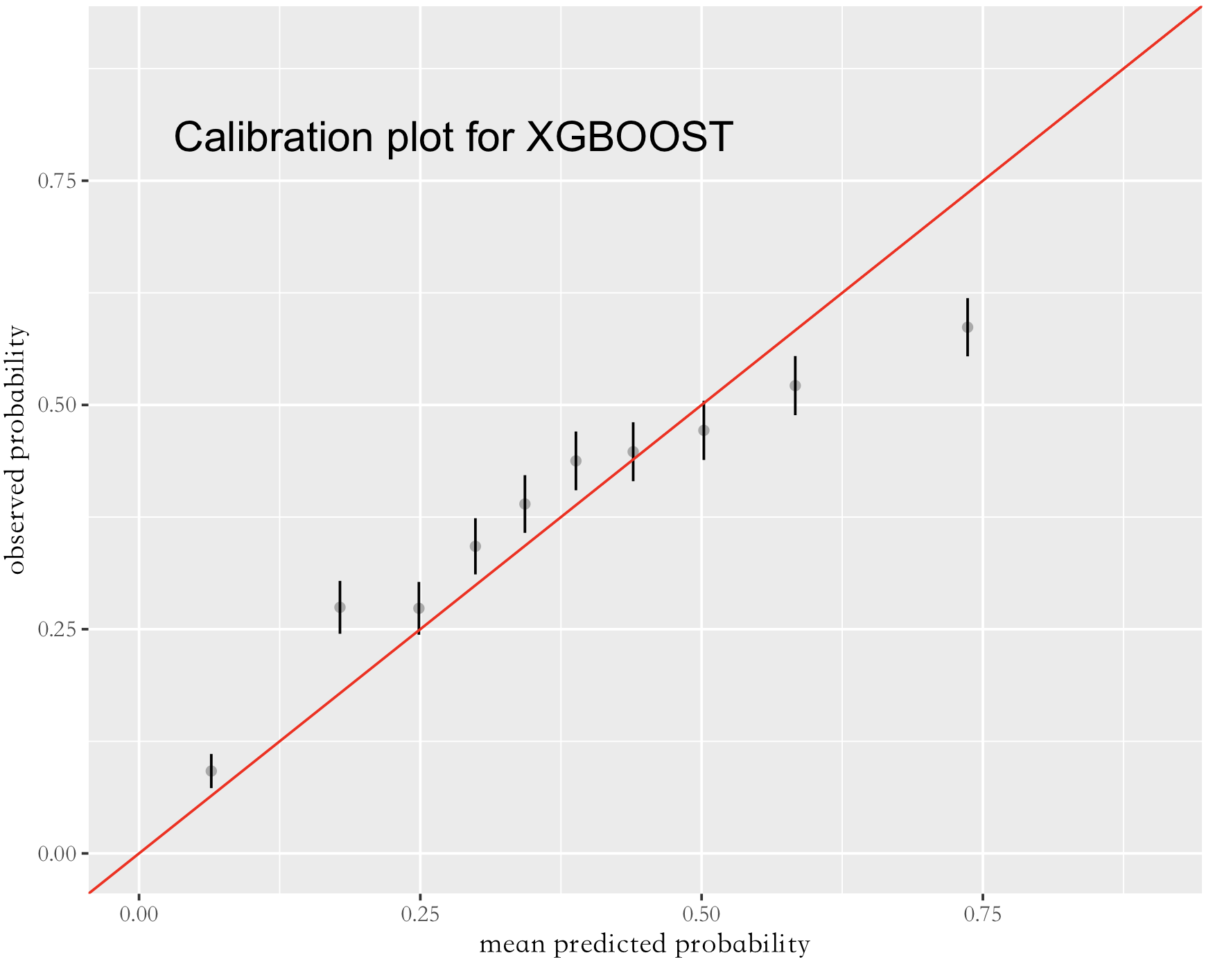
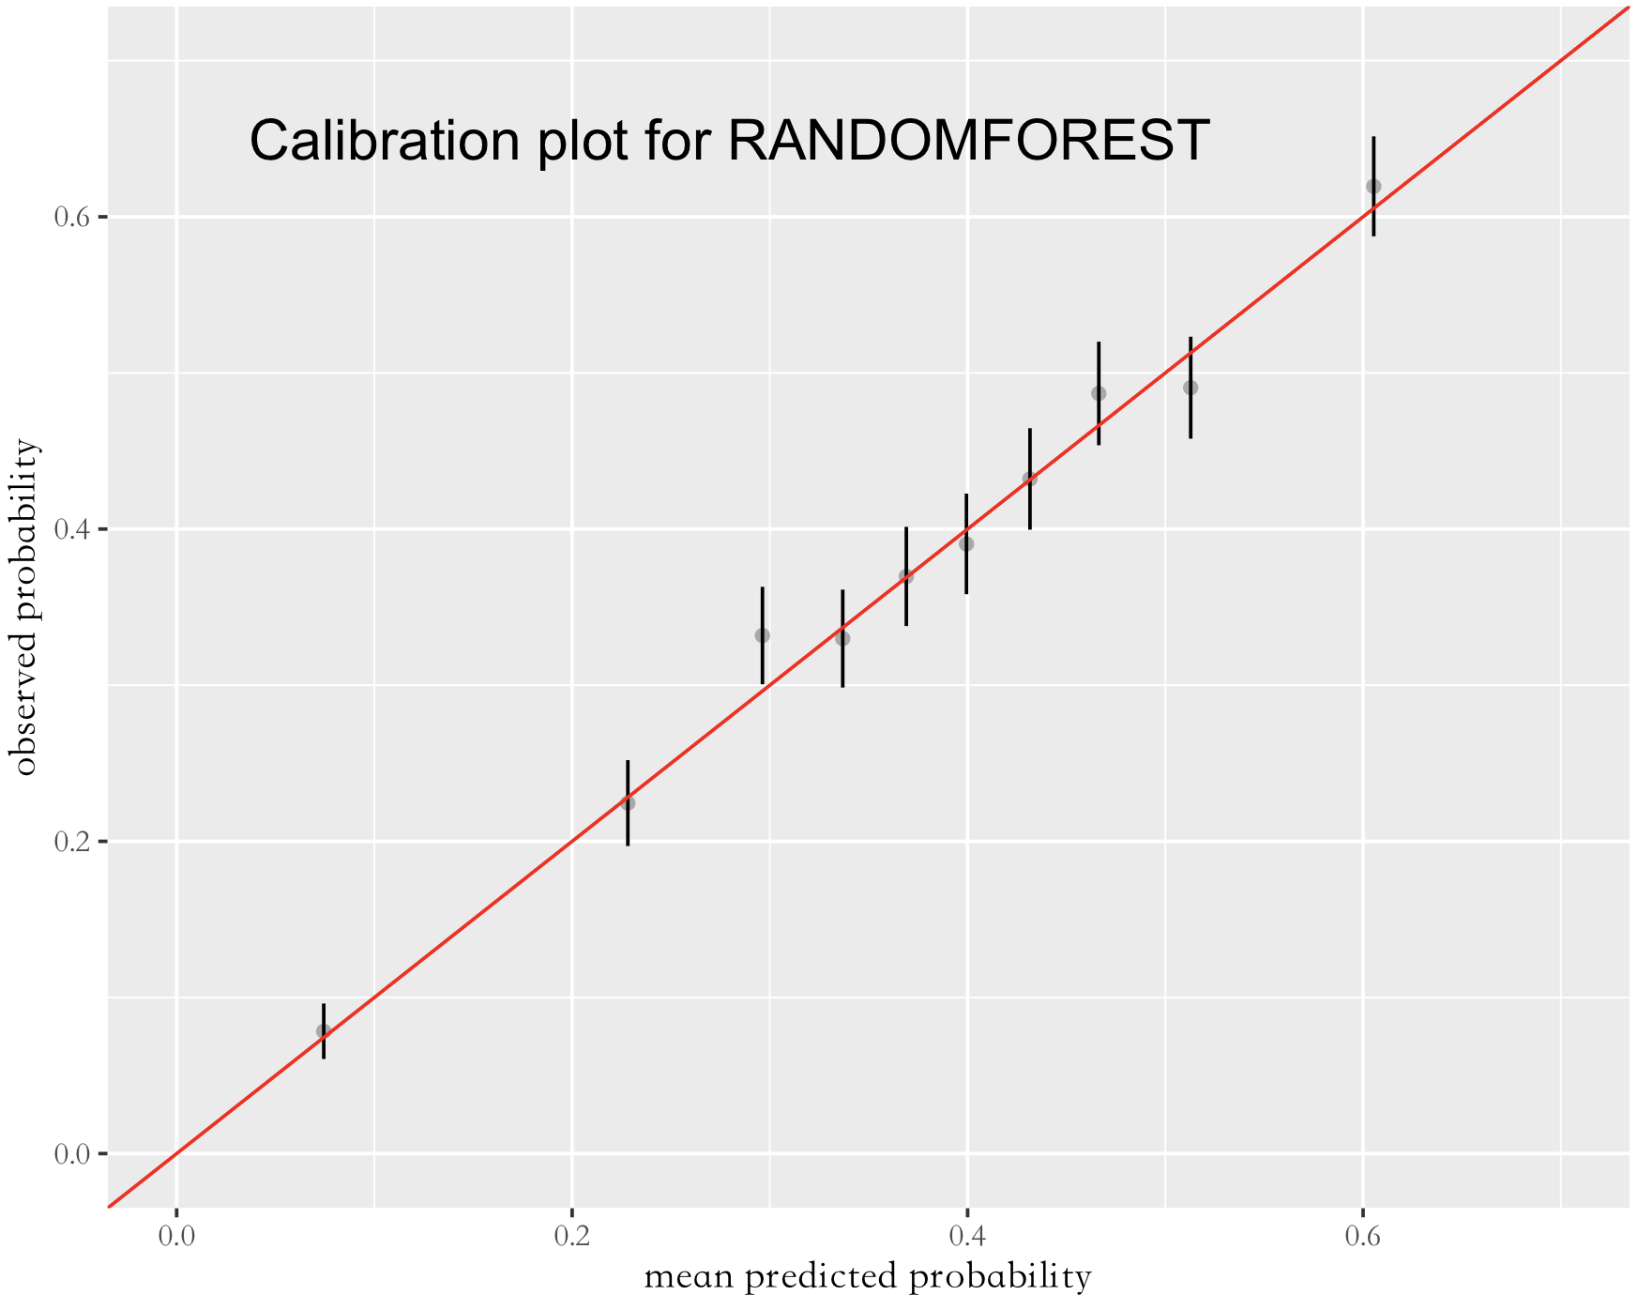
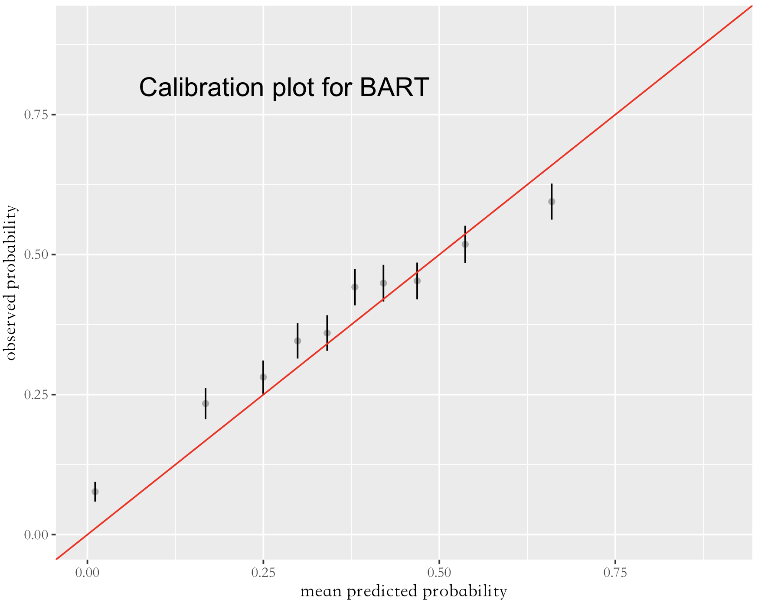
Calibration Plots
observed probability
observed probability
mean predicted probability
mean predicted probability
observed probability
observed probability
mean predicted probability
mean predicted probability

Slide 13
Prediction for Different Race Groups
 | Overall | White | Black or African American | Hispanic or Latino | Asian | Other | Declined
Proportion | 100% | 50% | 8% | 23% | 5% | 6% | 9%
True Engagement Rate | 38% | 39 % | 39% | 37% | 35% | 38% | 29%
Predicted by Lasso | 40% | 41% | 40% | 44% | 35% | 42% | 25%
Predicted by RF | 45% | 46% | 47% | 46% | 53% | 42% | 29%
Predicted by XGBoost | 42% | 44% | 41% | 45% | 41% | 43% | 27%
Predicted by BART | 42% | 43% | 45% | 45% | 44% | 37% | 29%

Slide 14
Feature Importance
Ranking | Lasso | RF | XGBoost | BART
1 | Cascade Select line of business | Line of Business | Risk score | Line of Business
2 | Medicare SNP line of business | Risk score | Age | No. CDPS condition
3 | Doctorate degree pct | Age | Revenue | Pregnancy flag
4 | Labor armed pct | Chronic condition count | Rx Expense | Chronic condition count
5 | BH Services Only line of business | Risk level | Expense | Revenue
6 | Medicare line of business | Revenue | Non-Rx Expense | Medicare line of business
7 | Pregnancy flag | Enrollment month | Line of Business | Spanish language

Slide 15
Discussion
The prediction accuracy is not high enough, but the models can still be somewhat useful
Possible reasons for the low prediction performance:
Some sparse variables may affect the model performance
Some key predictors are not in the dataset
Engagement is difficult to predict in nature
One similar paper in 2015: predict engagement in the High-Risk Case Management program for Medicare members who qualify; 21% engaged, accuracy 0.76, AUC score 0.74
Important features are helpful to understand engagement, though it is difficult to improve the engagement rate by manipulating them

Slide 16
Thanks for Your Attention!
Any questions?

Slide 17
Predictors
Demographic | Continuous | AGE, ADI_StateDecile, ADI_NationalDecile, no_school_pct, high_school_pct, some_college_pct, associate_degree_pct, bachelor_degree_pct, masters_degree_pct, professional_degree_pct, doctrate_degree_pct, married_child_under18pct, married_nochild_under18pct, single_parent_pct, public_assistance_pct, labor_civilian_all_pct, labor_civilian_unemp_pct, labor_armed_pct, No_labor_pct, no_vehicle_pct, one_vehicle_pct, under100FPL_pct, under200FPL_pct, foodstamps_SNAP_pct, vacant_pct
 | Categorical | sex, race, Ethnicity, Language, ZIPCLASS, RSA_Region, HOMELESS_IND
Medical | Continuous | risk_score, NONRX_PAID, RX_PAID, EXPENSE, REVENUE, MER_RATE, PCP_VST, PCP_VST_6MO, ER_CT_YR, ER_CT, IP_CT, HCC_CT, BP_COC_INDEX, BP_VST, SPEC_CT, AV_ER_CT_YR, AV_ER_CT
 | Categorical | SMOKE_DX, RISK, general_health, palliative, hospice, DD, Eye, Hematological, Skeletal, Psychiatric, Cardiovascular, Gastro, CNS, Infectious, Cancer, Metabolic, SA, Genital, Pulmonary, Cerebrovascular, Diabetes, Pregnancy, Skin, BH_IND, RX_IND, SUD_IND, SMI_IND, dementia_ind
Other | Continuous | start_month, calendar_YM, no_of_calls, n_tickets_complain, n_tickets_enquiry, no_cs_cat, MM_CT
 | Categorical | Mbr_No, case_management, health_coach, IsHealthHome_Eligible, HealthHome_Status, MHIP, Pref_Email, Pref_Call, Pref_mail, Pref_text

Slide 18
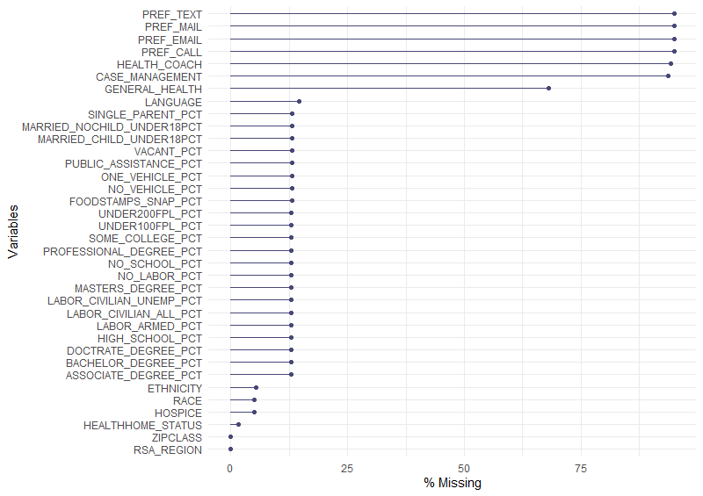
Missing Data

Slide 19
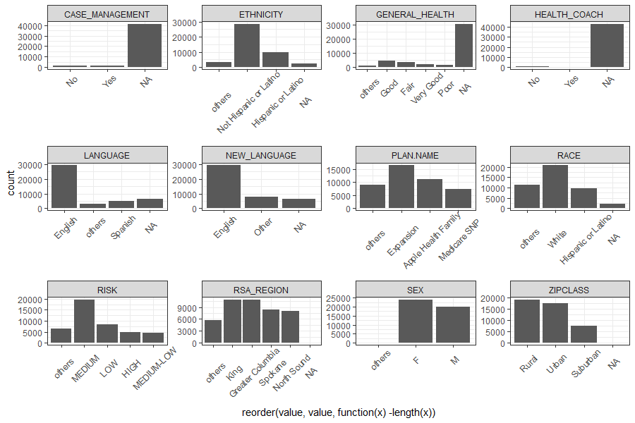
Exploratory Data Analysis
Categorical predictors

Slide 20
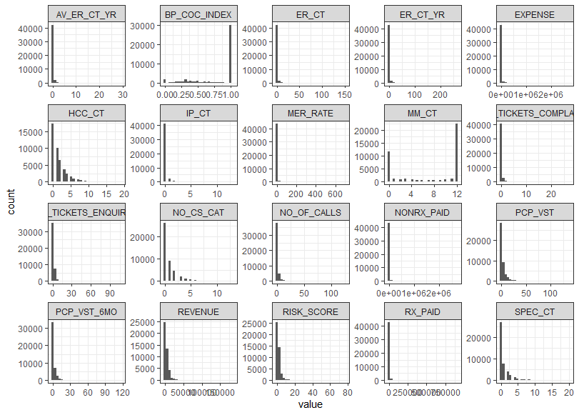
Exploratory Data Analysis
Continuous predictors

Slide 21
Lasso Regression
In statistics and machine learning, lasso is a regression analysis method that performs both variable selection and regularization in order to enhance the prediction accuracy and interpretability of the resulting statistical model. Though originally defined for linear regression, lasso regularization is easily extended to other statistical models including generalized linear models, generalized estimating equations, proportional hazards models.
Tuning Hyperparameter: fraction (L1 norm) in the elasticnet package. Its range is [0,1].
Reference: https://en.wikipedia.org/wiki/Lasso_(statistics)

Slide 22
Random Forest
Random forests or random decision forests is an ensemble learning method for classification, regression and other tasks that operates by constructing a multitude of decision trees at training time. For classification tasks, the output of the random forest is the class selected by most trees.
Tuning hyperparameters:
The number of trees in the forest
The number of features considered by each tree
The criteria with which to split on each node

Slide 23
XGBoost
Define:
A supervised learning algorithm
Attempts to accurately predict a target variable by combining the estimates of a set of simpler, weaker models.
Pros:
speed,
ease of use,
performance on large datasets
Cons:
Does not perform so well on sparse and unstructured data.

Slide 24
BART
BART (Bayesian Additive Regression Tree) is an ensemble technique based on the Bayes theorem which is used to calculate the posterior probability. Fitting and inference by this model are accomplished via an iterative Bayesian backfitting Monte Claro and Markov chain algorithm that generates samples from a posterior. Based on prior and likelihood, the output/predictions are generated.
Parameters：
ntree, n.trees — The number of trees in the sum-of-trees formulation.
Power — Power parameter for tree prior.
Base — Base parameter for tree prior.
References
Chipman, A H, George, I E, McCulloch, E R (2010). “BART: Bayesian additive regression trees.” The Annals of Applied Statistics, 4(1), 266--298.

Slide 25
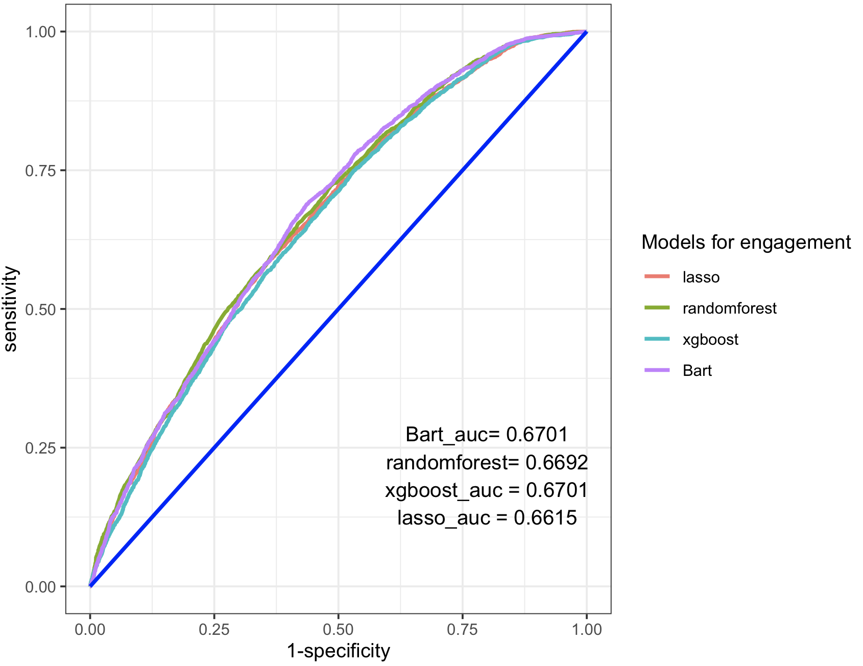
ROC Curves

